Slide 1


Mike Ames amesam@wfu.edu
Wake Forest
School of Business
_______
Decision Trees & Pipelines

Slide 2
What the heck is a decision tree?
Root Node
Decision node
Leaf Node
Leaf Node
Decision node
Leaf Node
Leaf Node

Slide 3
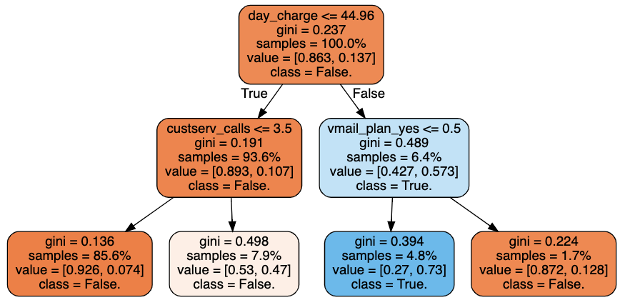
Churn Decision Tree

Slide 4
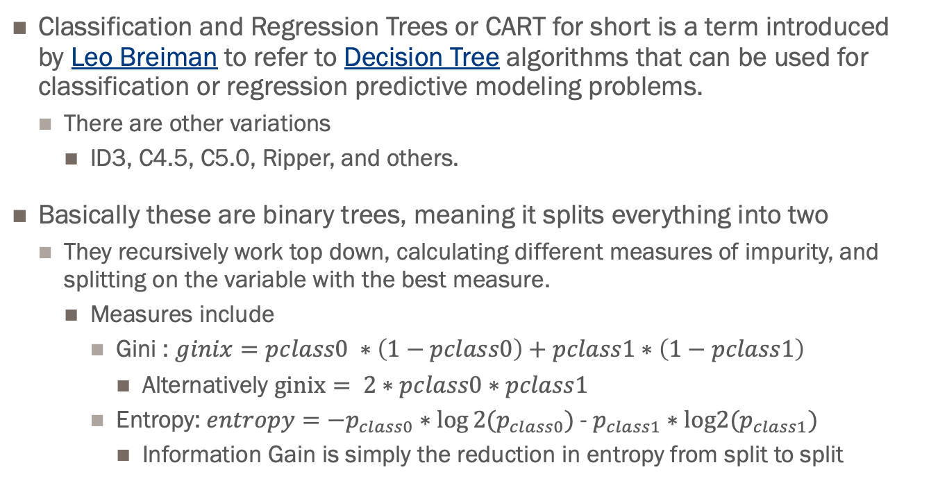
About Trees.
Classification and Regression Trees or CART for short is a term introduced by Leo Breiman to refer to Decision Tree algorithms that can be used for classification or regression predictive modeling problems.
There are other variations
ID3, C4.5, C5.0, Ripper, and others.
Basically these are binary trees, meaning it splits everything into two
They recursively work top down, calculating different measures of impurity, and splitting on the variable with the best measure.
Measures include
Gini : $ginix=pclass0 ∗\left(1−pclass0\right)+pclass1∗\left(1−pclass1\right)$
Alternatively $ginix= 2∗pclass0∗pclass1$
Entropy: $entropy={−p}_{class0}∗log⁡2(p_{class0})$ - $p_{class1}∗log2⁡(p_{class1})$
Information Gain is simply the reduction in entropy from split to split

Slide 5
Gini Impurity Splitting
Gini Impurity tells us what is the probability of incorrectly classifying an observation.
Ranges from 0 to 0.5
0 all one class – pure
0.5 a 50/50 split between classes
The lower the Gini the better the split, i.e. the lower probably of misclassifying.

Slide 6
Entropy – Another Split Strategy
Entropy is a measure of uncertainty.
Ranges from 0 to1
0 all one class – pure
1 a 50/50 split between classes
The lower the Entropy the better the split, i.e. the less uncertainty of misclassifying.

Slide 7
Decision Tree
Hyperparameters
Split Criteria ~ criterion, {“gini”, “entropy”}, The function to measure the quality of a split
Split Strategy ~ splitter, {“best”, “random”}, strategy used to choose the split at each node
Tree Depth ~ max_depth, maximum depth of the tree.
Min Samples Split ~ min_samples_split, minimum number of samples to be eligible for splitting
Min Samples Leaf ~ min_samples_leaf, minimum number of data points in a node that are required for the node to be split further. A split point at any depth will only be considered if it leaves at least min_samples_leaf
Minimal Cost Complexity ~ ccp_alpha, Minimal cost-complexity pruning is an algorithm used to prune a tree to avoid over-fitting. Default is 0 i.e. no pruning.
https://scikit-learn.org/stable/modules/generated/sklearn.tree.DecisionTreeClassifier.html

Slide 8
Preparing Data for Trees
Deal w. Categorical
One Hot Encoding
Turn every category into a column where 1 if present and 0 if not
Categorical Column is
Transformed into 0/1s
1-Hot Encoded
Category |  | Red | Green | Blue
Red |  | 1 | 0 | 0
Green |  | 0 | 1 | 0
Blue |  | 0 | 0 | 1
Red |  | 1 | 0 | 0
Red |  | 1 | 0 | 0
Red |  | 1 | 0 | 0
Red |  | 1 | 0 | 0
Green |  | 0 | 1 | 0
Green |  | 0 | 1 | 0
Green |  | 0 | 1 | 0

Slide 9
Preparing Data for Trees
Missing Values Numeric
Numeric
Replace with a Default -1, Mean, Median etc.
Numeric | Numeric Transformed
38 | 38
15 | 15
53 | 53
 | -99
45 | 45
 | -99
35 | 35
 | -99
29 | 29
50 | 50

Slide 10
Preparing Data for Trees
Missing Values - Categorical
Categorical 2 Step process
Replace with a Default “Missing” or Mode
Then 1-Hot Encode
Categorical Columns
First Replace Nulls THEN Transformed into 0/1s
1-Hot Encoded
Category | Cat Transformed |  | Red | Green | Blue | Missing
Red | Red |  | 1 | 0 | 0 | 0
Green | Green |  | 0 | 1 | 0 | 0
Blue | Blue |  | 0 | 0 | 1 | 0
Red | Red |  | 1 | 0 | 0 | 0
 | missing |  | 0 | 0 | 0 | 1
Red | Red |  | 1 | 0 | 0 | 0
Red | Red |  | 1 | 0 | 0 | 0
Green | Green |  | 0 | 1 | 0 | 0
 | missing |  | 0 | 0 | 0 | 1
Green | Green |  | 0 | 1 | 0 | 0

Slide 11

scikit-learn
Common interfaces and utilities to streamline your workflow

Slide 12
It’s all about the pipes…
Pipelines are a set of utilities and transformers
Linear sequence of transformations
Chain them together with a modeling method
Supports custom transformers
Supports hyper parameter optimization
Supports cross folds, grid searches, and other schemes
Etc.
Standardizes the workflow
Avoid data leakage (to some degree)
Simplify the process
Self documenting
Easy to experiment
Tune rinse repeat.

Slide 13
Representing Data
one sample
1.1 | 2.2 | 3.4 | 5.6 | 1.0
6.7 | 0.5 | 0.4 | 2.6 | 1.6
2.4 | 9.3 | 7.3 | 6.4 | 2.8
1.5 | 0.0 | 4.3 | 8.3 | 3.4
0.5 | 3.5 | 8.1 | 3.6 | 4.6
5.1 | 9.7 | 3.5 | 7.9 | 5.1
3.7 | 7.8 | 2.6 | 3.2 | 6.3
1.6
2.7
4.4
0.5
0.2
5.6
6.7
X =
y =
one feature
outputs / labels

Slide 14
Most basic Pipeline
#- initialize our classifier
clf = DecisionTreeClassifier(hyperparameters… )
clf.fit(X_train, y_train)
Training Data
Model
Training Labels
y_pred = clf.predict(X_test)
Test Data
Prediction
y_prob = clf.predict_proba(X_test)
Test Labels
Evaluation

Slide 15
Basic API
estimator.fit(X, [y])
estimator.predict | estimator.transform
Classification | Preprocessing
Regression | Dimensionality reduction
Clustering | Feature selection
 | Feature extraction

Slide 16
Pipeline Fit
pipe = make_pipeline( Transformer1(),
Transformer2(),
Classifer())
pipe.fit(X,y)
make_pipeline is a short cut to creating a pipeline, simply defines the sequence of steps to apply to X
The result of each ”fit” is both a matrix of transformed data and an artifact( instructions) of what to apply to new data.
Artifact – suppose you fill missing data with the MEAN of the column, you need to store the mean of each column so that it can be applied to new data.
Question 1 - why couldn’t you just apply the mean of the new data?
Transformer1.fit(X,y)
X1
Transformer2.fit(X1,y)
X2
classifier.fit(X2,y)

Slide 17
Pipeline Predict
pipe.predict(X’)
Transformer1.transform(X’)
X’1
Transformer2.transform(X1’)
X’2
Classifier.predict(X2’)
y’
X’ is new data that the pipeline(model) hasn’t seen, it applies the artifacts to the new data
Remember that artifact that replaces missing values with the mean? The transformer applies that mean to new data.
Question 2. Why might this be problematic?
df[‘feature'] = df[‘feature'].fillna((df[‘feature'].mean()))

Slide 18
What If you only want to transform?
Transformation only pipelines…
from sklearn.preprocessing import OneHotEncoder
onehot = OneHotEncoder(handle_unknown=‘ignore’)
onehot.fit(X) – calculates parameters
onehot.transform(X) – applies parameters
OR
onehot.fit_transform(X) – does both

Slide 19
Encoders’ methods
Standard API makes life easy
fit(self, y) | Fit encoder
fit_transform(self, y) | Fit encoder and return encoded labels
get_params(self[, deep]) | Get parameters for this estimator.
inverse_transform(self, y) | Transform back to original encoding.
set_params(self, \*\*params) | Set the parameters of this estimator.
transform(self, y) | Transform labels to normalized encoding.
Feature Extractors’ methods
fit(self[, X, y]) | No-op.
fit_transform(self, X[, y]) | Fit to data, then transform it.
get_params(self[, deep]) | Get parameters for this estimator.
set_params(self, \*\*params) | Set the parameters of this estimator.
transform(self, raw_X) | Transform a sequence of instances to a scipy.sparse matrix.

Slide 20
Let’s get hands on
Grab the materials
Sklearn-Pipeline-Brownbag_2019.ipynb
Upload notebook to your Jupyter and follow along.

Slide 21
It’s all about the pipes…
Pipelines are a set of utilities and transformers
Linear sequence of transformations
Chain them together with a modeling method
Supports custom transformers
Supports hyper parameter optimization
Supports cross folds, grid searches, and other schemes
Etc.
Standardizes the workflow
Avoid data leakage (to some degree)
Simplify the process
Self documenting
Easy to experiment
Tune rinse repeat.

